Slide 1
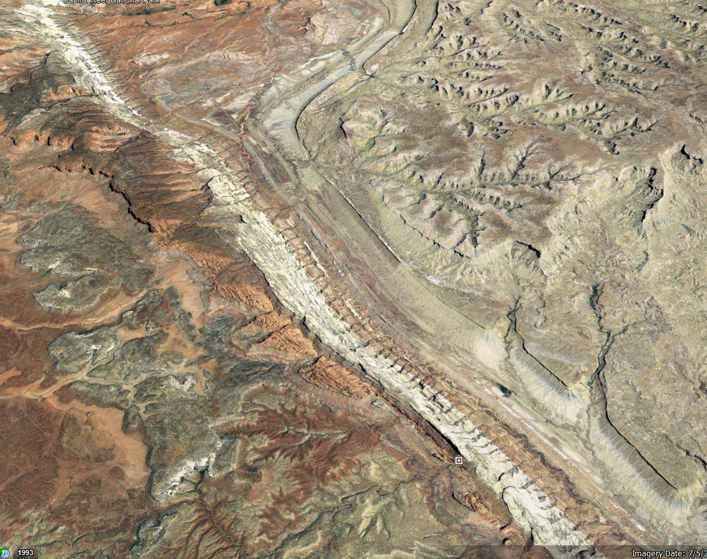
Deriving Above Ground Biomass using Modis NDVI in Google Earth Engine
Sandy 3 Allotment

Slide 2
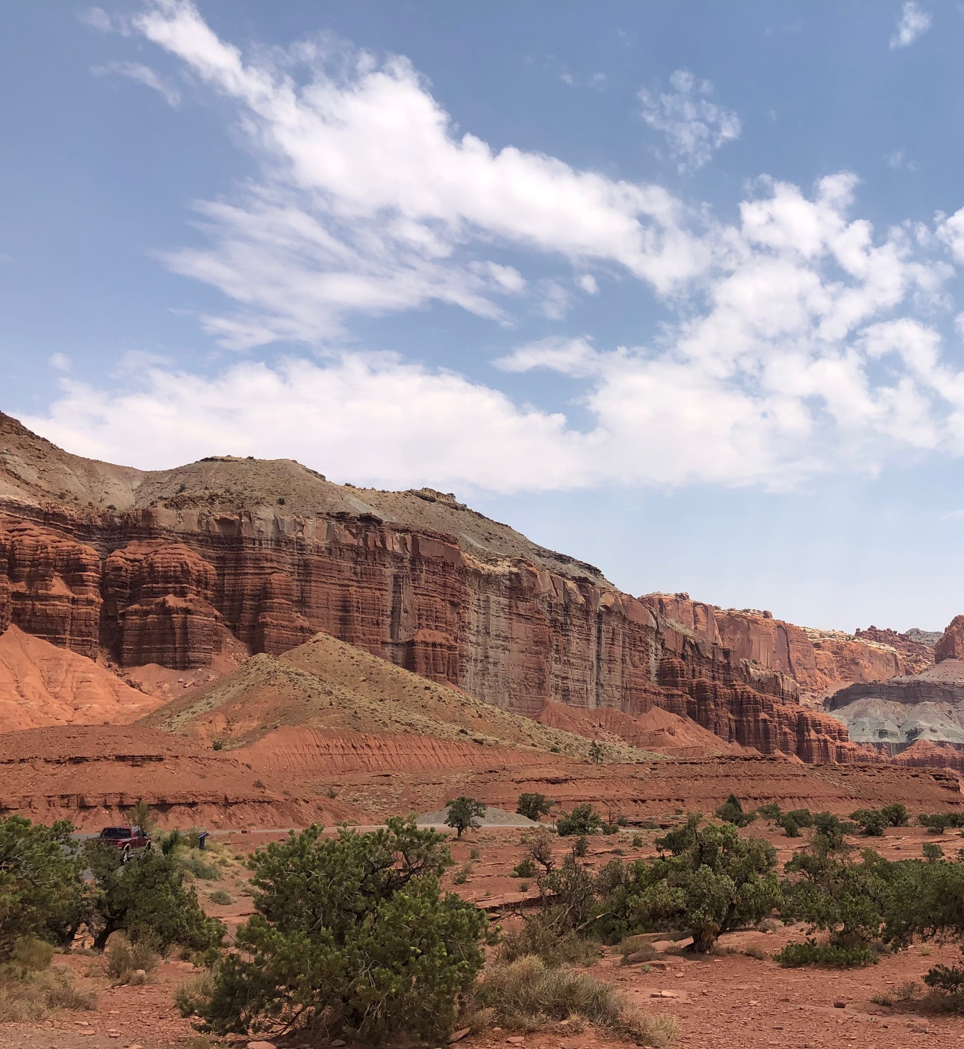
Goals
Develop a way to estimate above ground biomass (AGB) in Google Earth Engine using NDVI data at Sandy-3 Allotment
Develop periodic relationships between water balance variables and NDVI at Sandy-3 Allotment

Slide 3
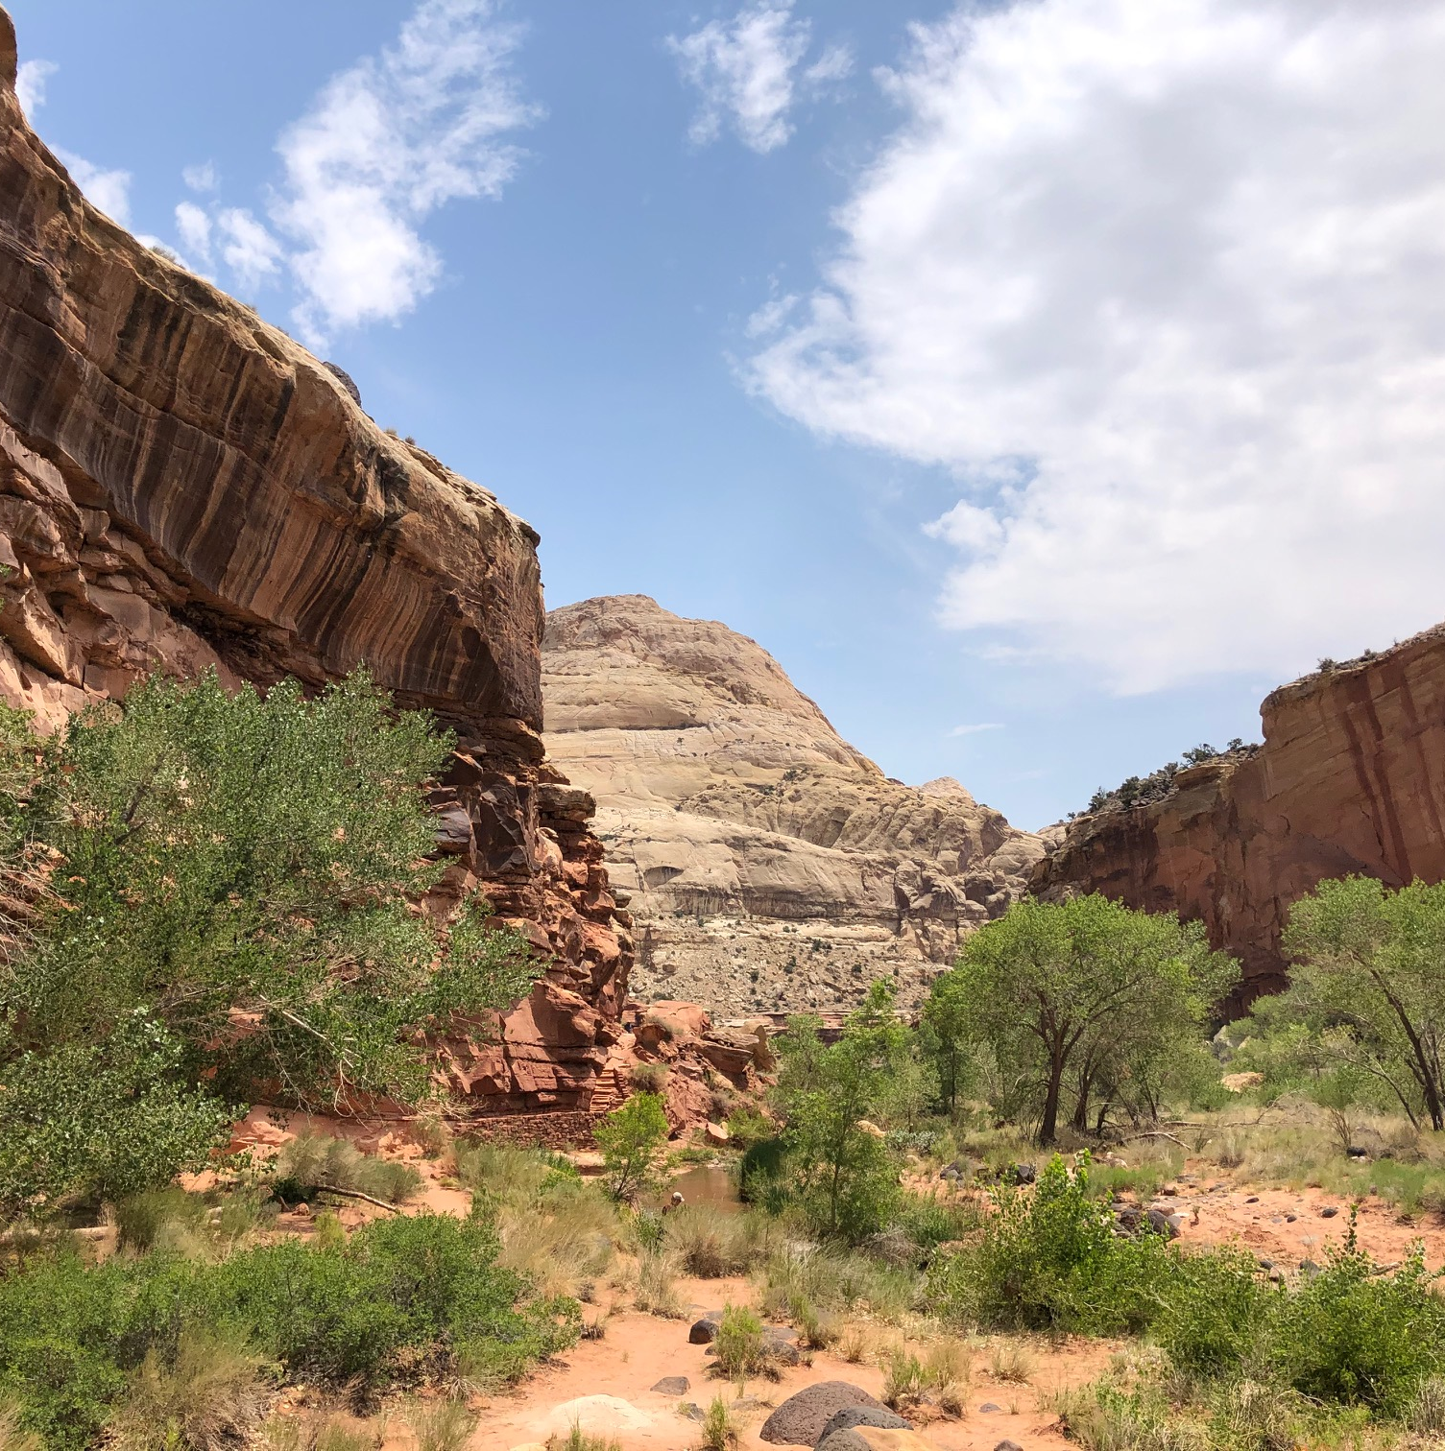
Data Sources
CARE HQ daily station data
MODIS Terra 16-Day
Daymet daily 1km at Sandy 3
Used to fill blank missing data in CARE HQ daily station data
Vp, SWE, and sRad (incorporated through 2020)

Slide 4
Water balance/NDVI relationship analyses
Growing Season Periodic Linear Relationships
K-fold (5) Cross Validation
Metrics of Comparison: r² & Root Mean Squared Error
ARIMAX (single & Multivariate)
Train Data = 0.75, Test Data =0.25 (last 5 years)
Examined using 0 lags
Metrics of Comparison: Root Mean Squared Error
Earth.Google.com

Slide 5
Overview of Sandy-3 Allotment

Slide 6
June NDVI from 2000-2021 at Sandy 3 Allotment

Slide 7
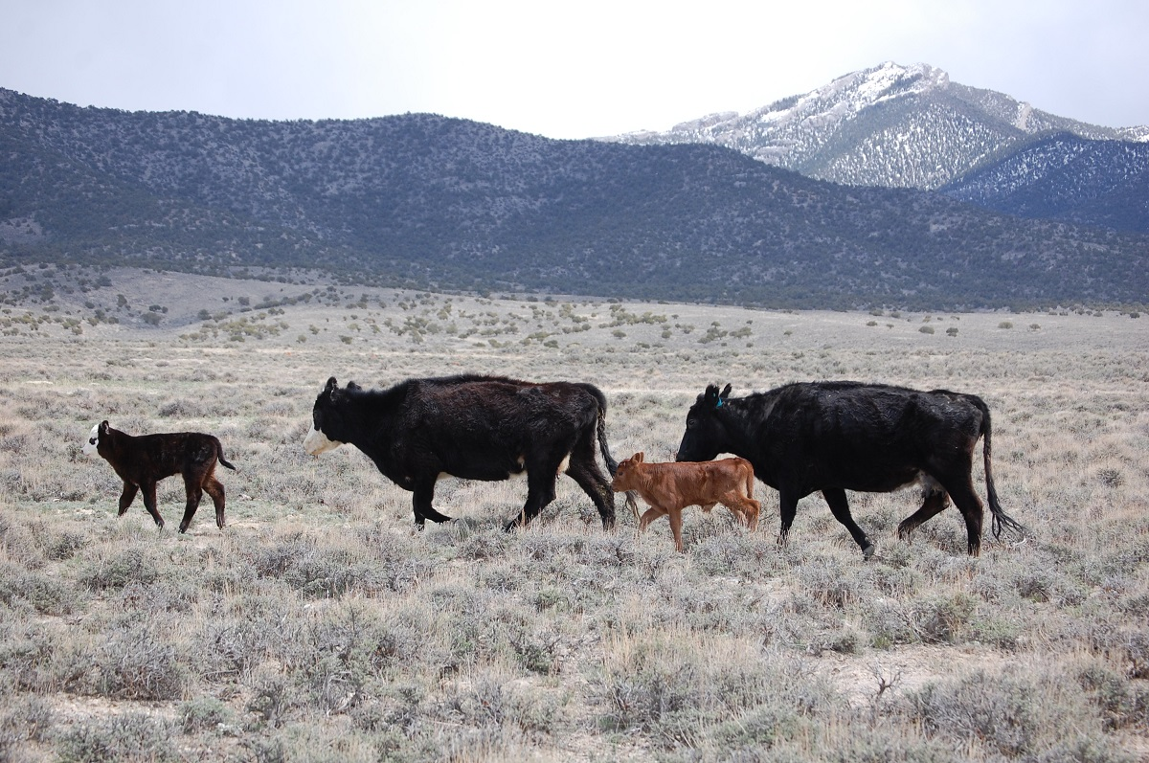
Nakano et. Al. established a strong linear relationship between Modis NDVI data and AGB in semi-arid grasslands of Mongolia [1].
R2 = 0.861 [1]
AGB [g/m^2] = -38.3 + (NDVI*277.9) [1]
https://www.blm.gov/programs/natural-resources/rangeland-and-grazing/rangeland-health/utah

Slide 8
GEE Script to Extract NDVI and AGB from Sandy 3 allotment
https://code.earthengine.google.com/3df4c67181acdd06ad79279bc4f24107

Slide 9
Extracting AGB [lb/acre] from GEE Script
Step 1: Run GEE Script
Step 2: Go to Tasks panel and select Run next to AGB timeSeries
Step 3: Select Drive and click Run on pop up. This will send the time series CSV to your Google Drive where it can then be downloaded

Slide 10
Comparison of Modis Derived AGB and Rangeland App AGB

Slide 11
Comparison of Modis Derived AGB and Rangeland App AGB

Slide 12
Periodic relationships between NDVI and water balance variables during growing season
Data split into 16-day periods based on Modis imaging collection windows (23 periods altogether)
Growing season from March to October
5-fold cross validation
Average of train data r2 values after cross validation reported and used to determine best predictor during each period
Average of test data rMSE after cross validation reported

Slide 13
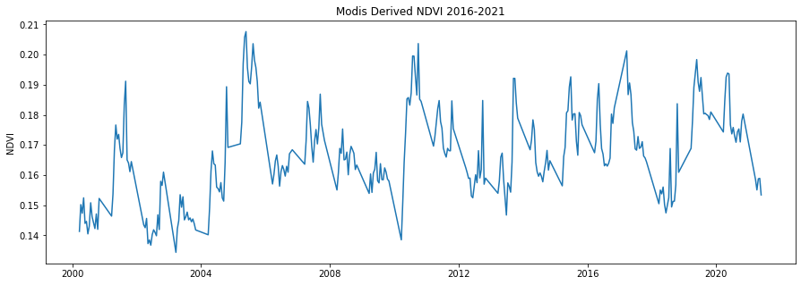
Modis derived NDVI data from 2016-2021 growing seasons

Slide 14
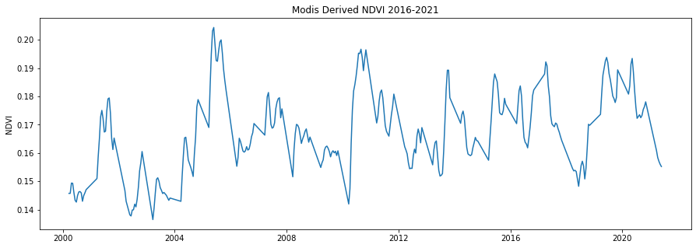
Modis derived NDVI with Savitsky Golay smoothing filter applied

Slide 15
Comparison of rMSE ARIMAX models with different features
2000 – 2015 Growing Season data used to train Arimax models
2016 – 2021 data used as hold out test data in order to calculate

Slide 16
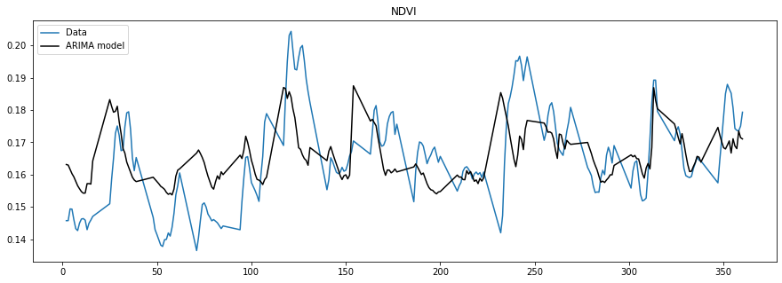
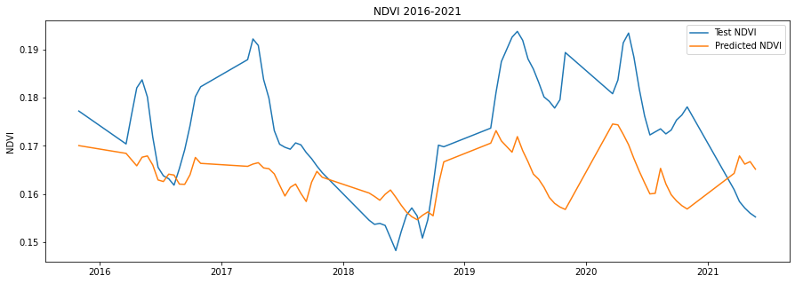
Soil Moisture is predictor with lowest Root MSE
rMSE = 0.0136762

Slide 17
Conclusions
Modis derived NDVI can be used to approximate above ground biomass in the Sandy-3 allotment
Strong linear relationships between periodic water balance variables and NDVI persist from late April through July.
Water balance variables can be used as a proxy for NDVI, especially during the height of the growing season (May 25 to June 25).
Single variable linear relationships showed lower root mean squared error with test data than Arimax models

Slide 18
Future Areas of Exploration
Collect clippings from Sandy-3 allotment to validate AGB estimates, or build site specific relationship between NDVI and AGB
Developing Water balance relationships with Gridmet data to be able to forecast AGB at the Sandy-3 allotment 30 days out.

Slide 19
References
[1] Nakano, T., Bavuudorj, B., G. Urianhai, N., Shinoda, A. (2013). Monitoring aboveground biomass in semiarid grasslands using MODIS images. Journal of Agricultural Meteorology, 69 (1), 33–39.

